Slide 1
Accessibility: Why it matters
By David A. Kennedy, @DavidAKennedy

Slide 2

Who I Am
Organization: The Arc
Job: Web Guy
Passion: Building stuff
Site: www.thearc.org
Facebook: TheArcUS
Twitter: @TheArcUS

Slide 3

There’s More!
I blog about being a web guy.
I’m also here:
davidakennedy.com
@DavidAKennedy

Slide 4

Where We’re Headed
What is Accessibility?
Why it’s Important
What You Can Do
Resources for Learning More

Slide 5

What We’re Not Doing
I’m not going to teach you how to make a website accessible.
I’m not going to get technical – hopefully!

Slide 6

Thanks WebAIM!
This presentation is adapted from WebAIM’s Introduction to Web Accessibility.

Slide 7

What is Accessibility?
“Web accessibility means that people with disabilities can use the Web” –
The Word Wide Web Consortium on accessibility

Slide 8

Major Types of Disabilities
Visual
Hearing
Motor
Cognitive

Slide 9
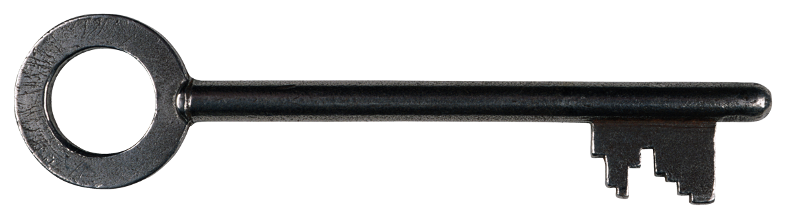
Understanding Accessibility
It’s not a checklist!
It’s part of the web design/web project process.
Yes, it takes more time, not more money – can save it!

Slide 10

Making it All Work: Organization
Awareness
Leadership
Policies and Procedures

Slide 11
Making it All Work: Practice
Perceivable
Operable
Understandable
Robust

Slide 12
Making it All Work: Law
ADA
IDEA
Rehabilitation Act of 1973 (Sections 504 and Section 508)

Slide 13

Why It’s Important
One User who’s blind said:
“… I’m 90 percent sure I’ll have a problem with [sites] …” – from
WebAIM video

Slide 14

Be an Accessibility Advocate
Be positive
Let site administrators know of your trouble, and be specific
Send resources

Slide 15

A Few Resources
WebAIM.org
W3C
Web Standards Project

Slide 16
Thank You! Fore More
Download the presentation:
http://davidakennedy.com/blog/2011/09/18/accessibility-why-it-matters/
I’m also here:
davidakennedy.com
@DavidAKennedy

